Slide 1
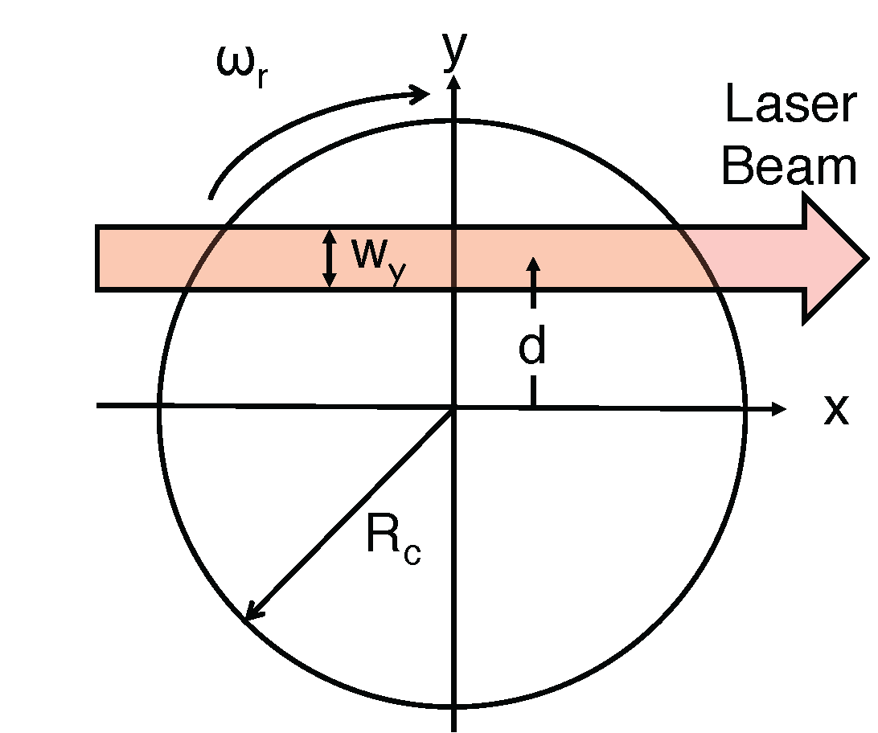
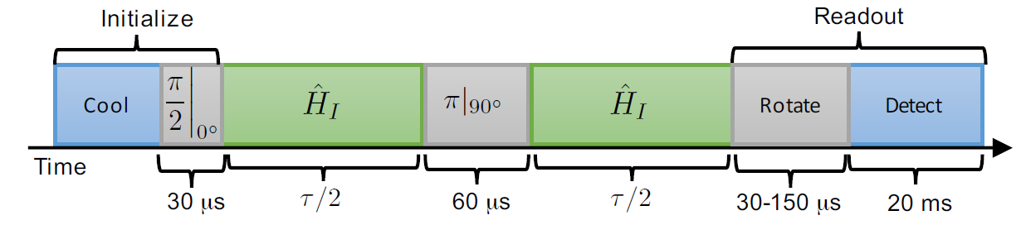
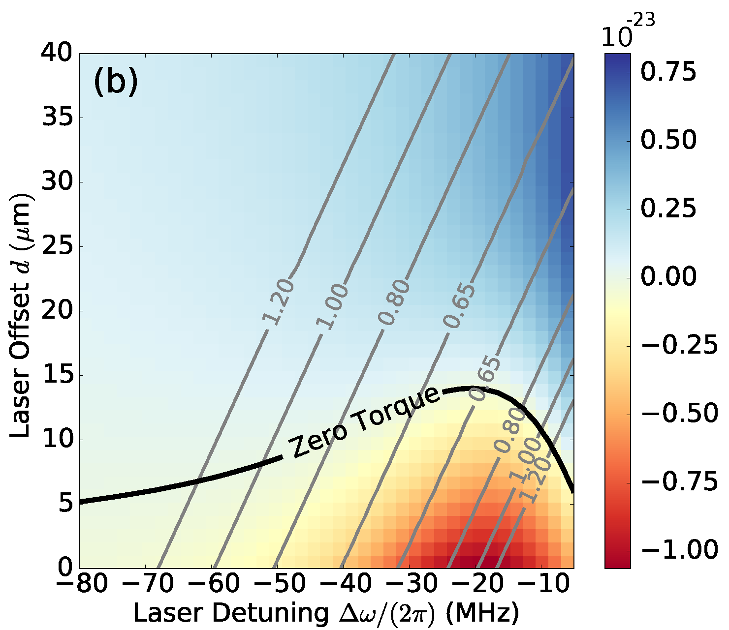
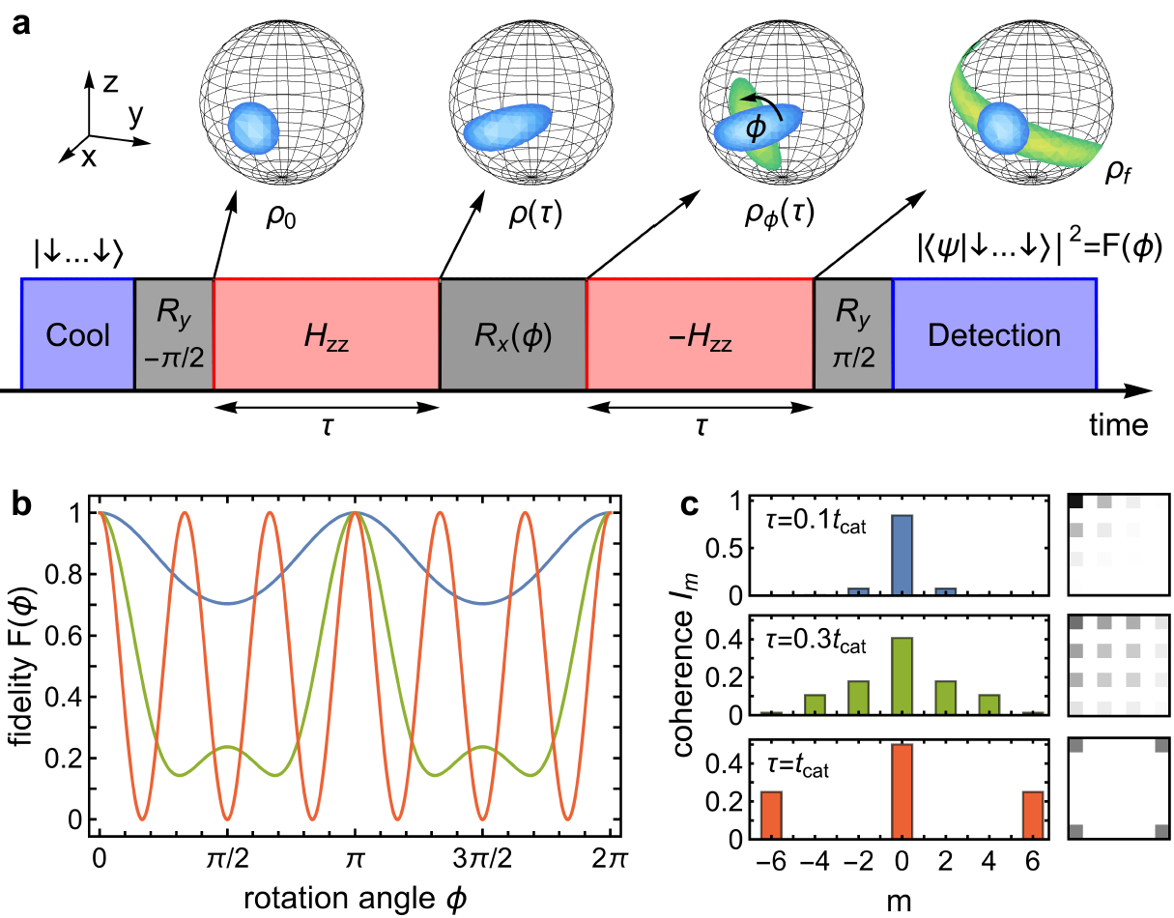
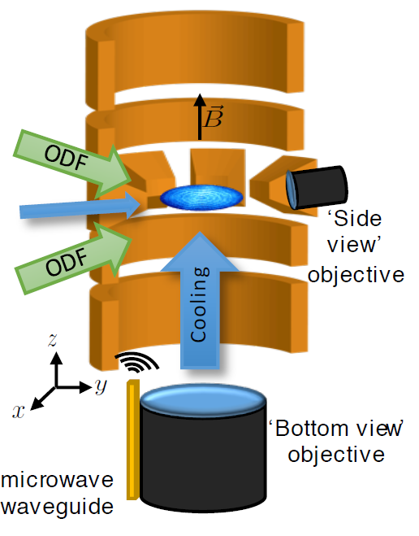
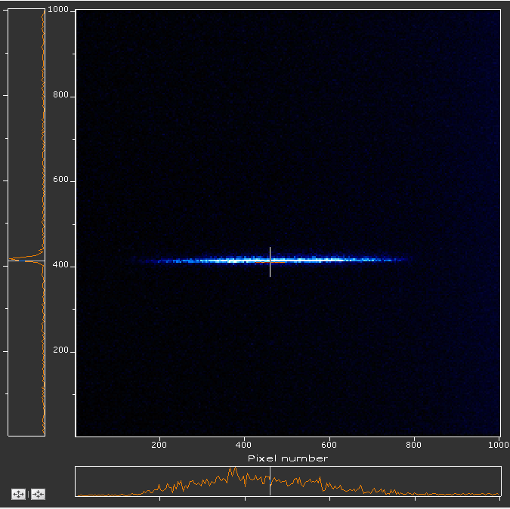
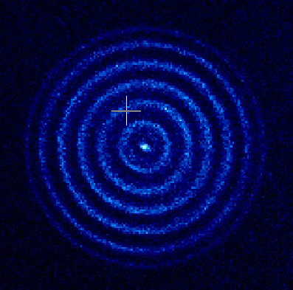
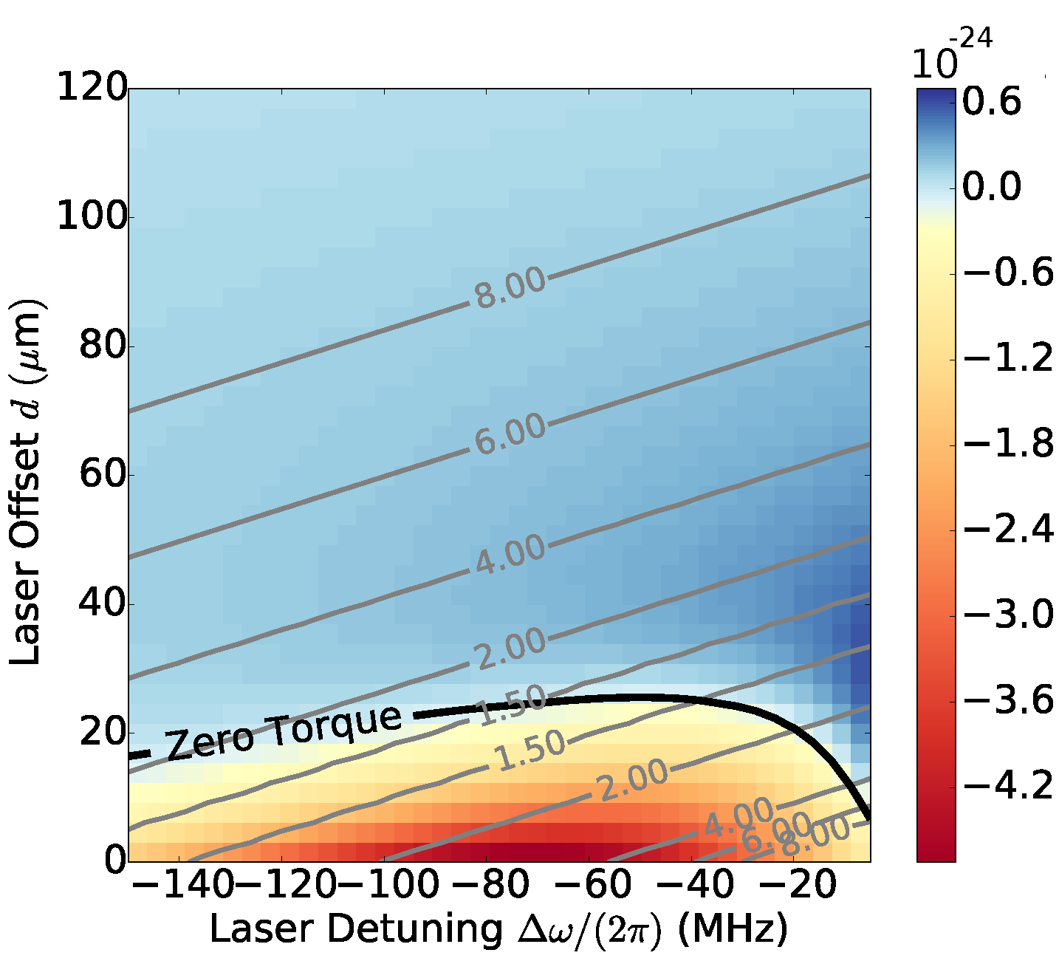
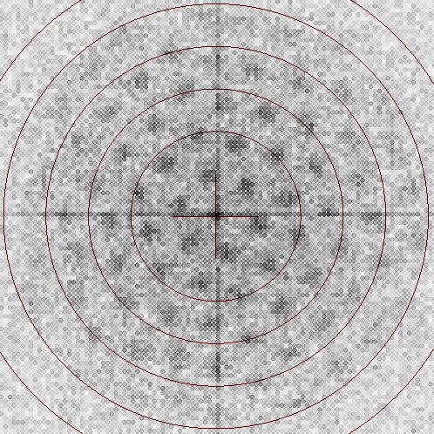
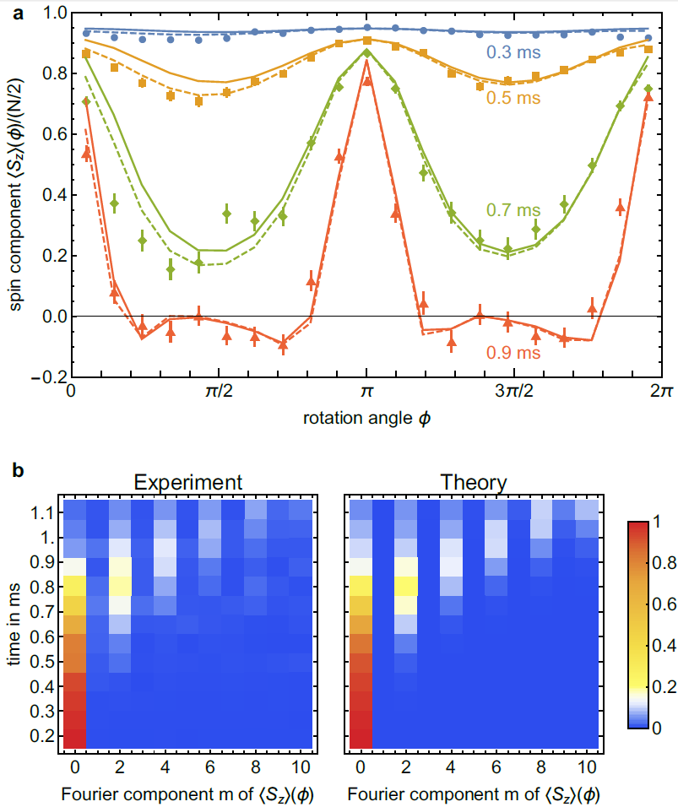
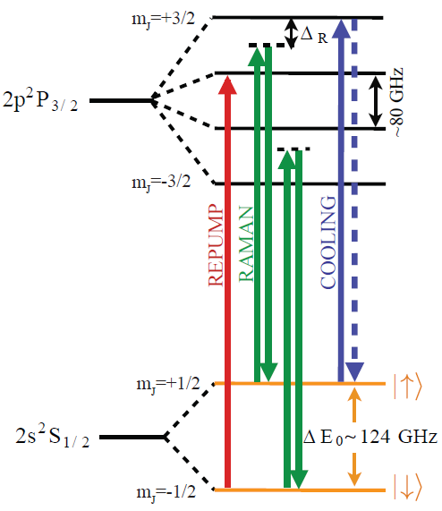
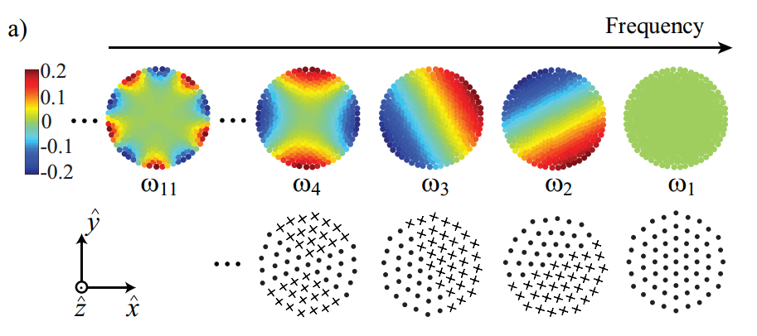
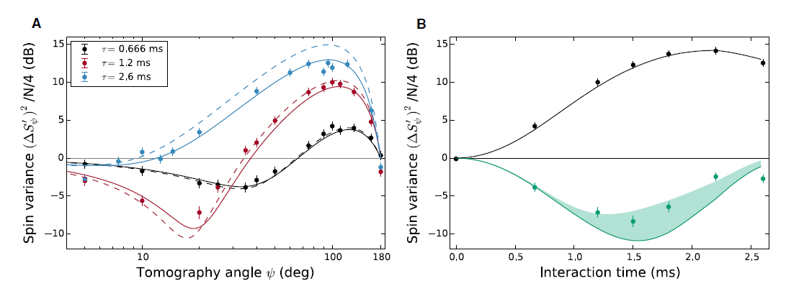
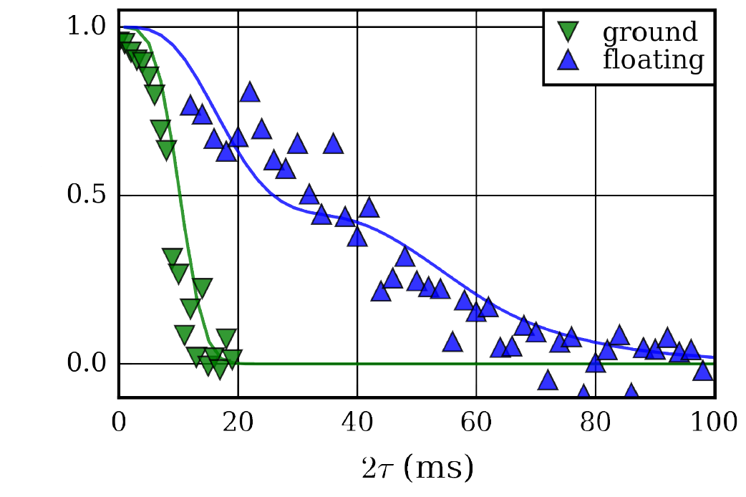
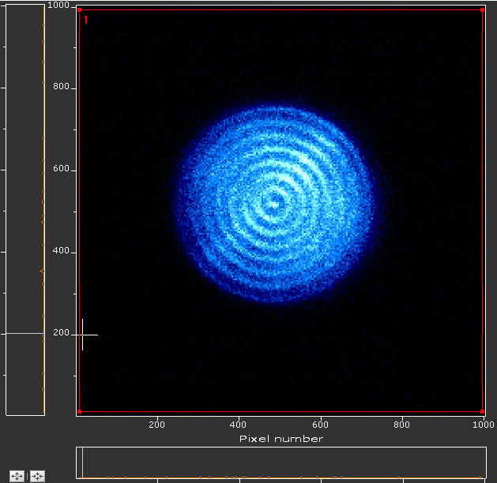
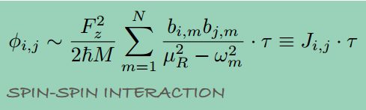
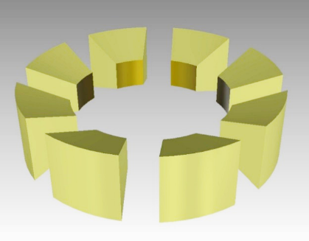
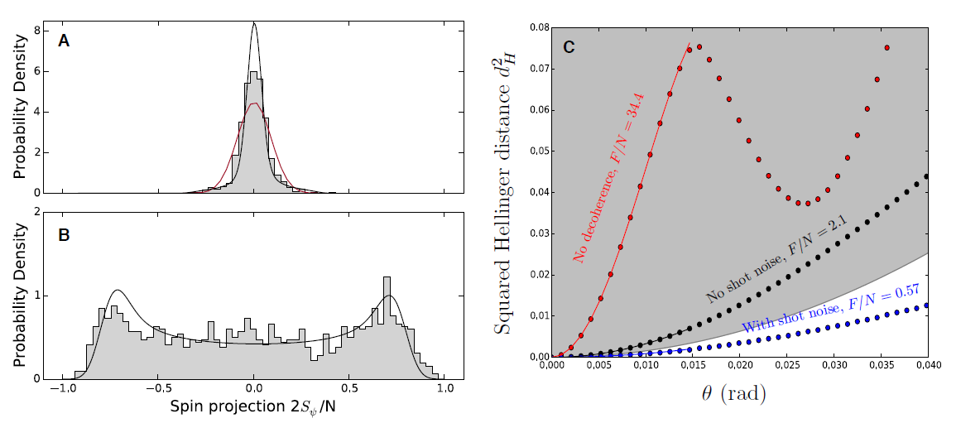
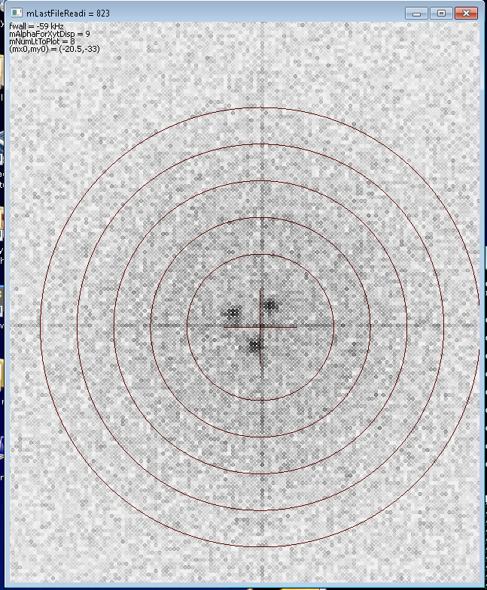
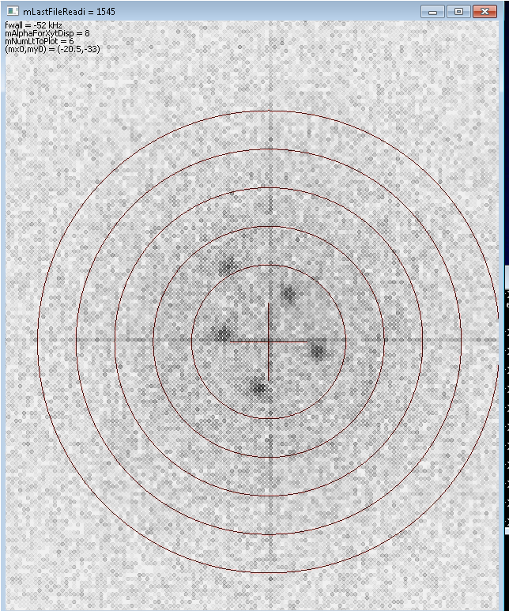
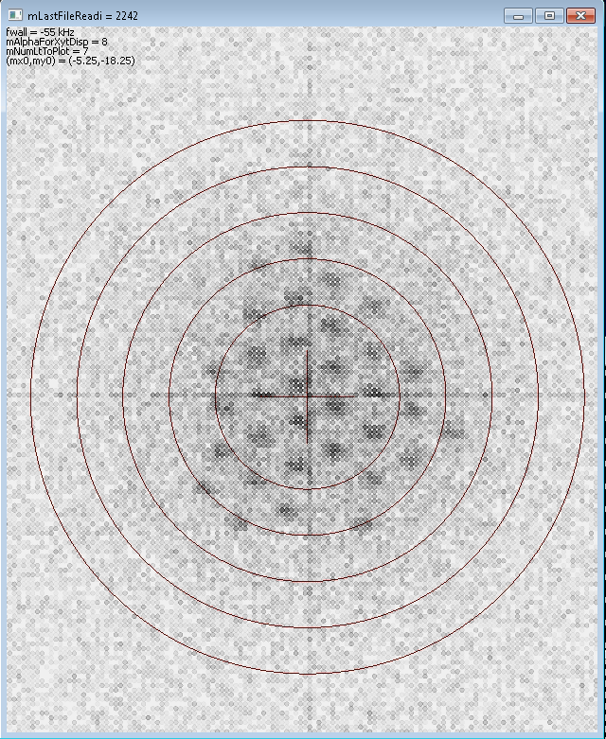
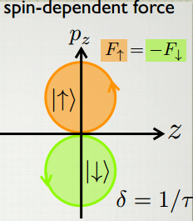


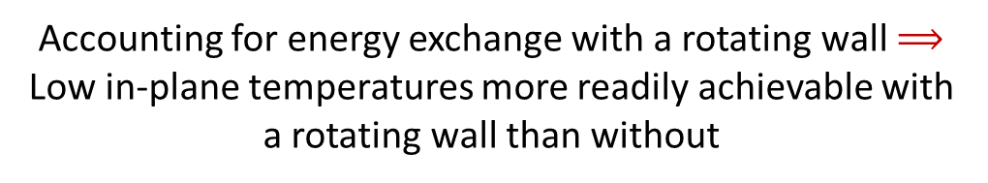
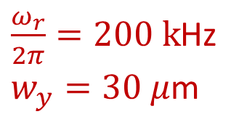
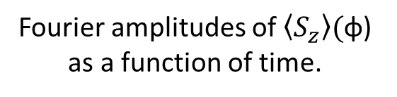
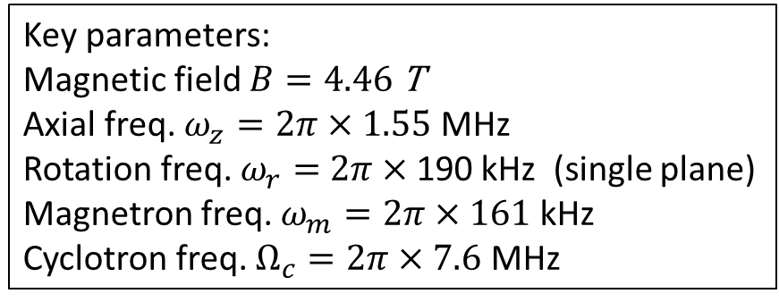
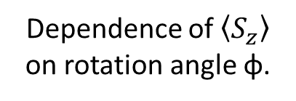
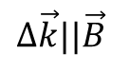
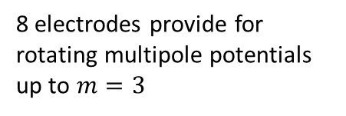
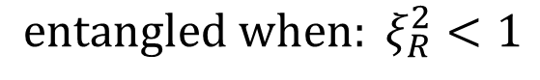
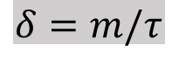
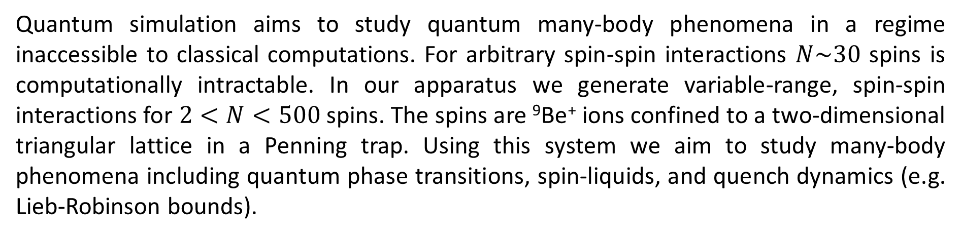
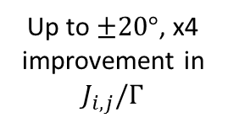
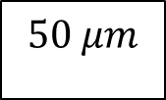
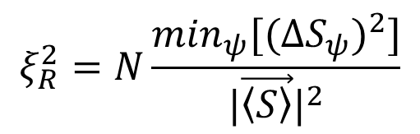
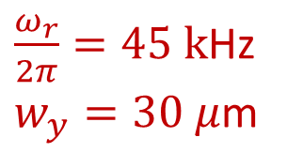

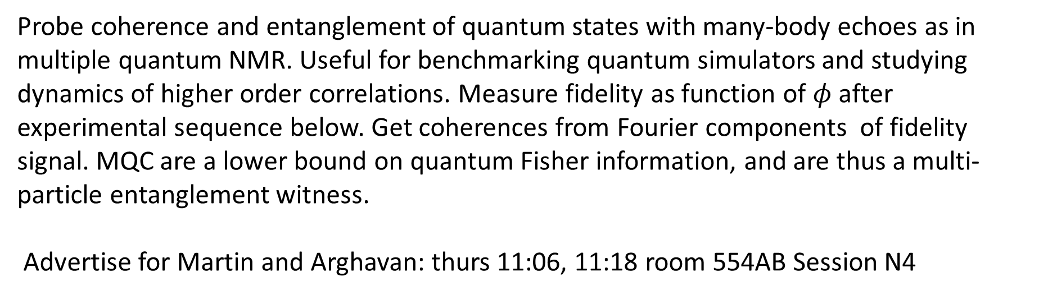
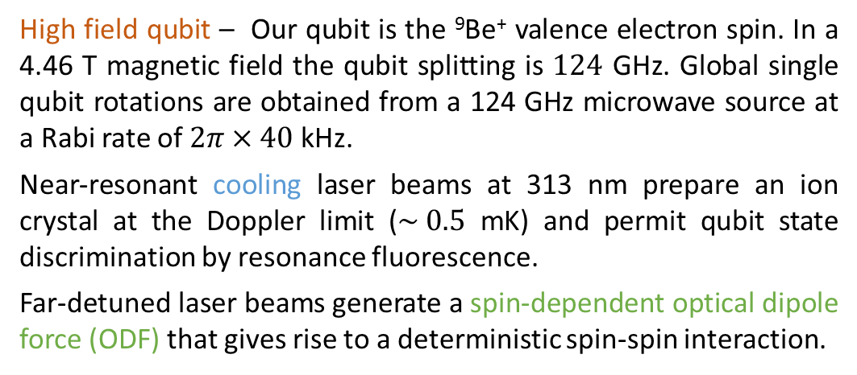
Motivation
Perpendicular laser cooling
with a rotating wall
Torrisi, Britton, Bohnet, Bollinger, PRA 93 (2016)
Spin squeezing and entanglement
Multiple quantum coherences
Quantum simulation aims to study quantum many-body phenomena in a regime inaccessible to classical computations. For arbitrary spin-spin interactions $N\sim 30$ spins is computationally intractable. In our apparatus we generate variable-range, spin-spin interactions for $2<N<500$ spins. The spins are ⁹Be⁺ ions confined to a two-dimensional triangular lattice in a Penning trap. Using this system we aim to study many-body phenomena including quantum phase transitions, spin-liquids, and quench dynamics (e.g. Lieb-Robinson bounds).
Bohnet, et al, arXiv:1512.03756 to be published in Science
Probe coherence and entanglement of quantum states with many-body echoes as in multiple quantum NMR. Useful for benchmarking quantum simulators and studying dynamics of higher order correlations. Measure fidelity as function of $φ$ after experimental sequence below. Get coherences from Fourier components of fidelity signal. MQC are a lower bound on quantum Fisher information, and are thus a multi-particle entanglement witness.
Advertise for Martin and Arghavan: thurs 11:06, 11:18 room 554AB Session N4
Benchmarking of quantum correlations and many-body physics in open quantum system.
Experimental measurement of Ising spin dynamics demonstrating entanglement by observing spin squeezing and acquiring full counting statistics. Examine interplay between correlations / entanglement and decoherence in open quantum system.
Accounting for energy exchange with a rotating wall $⟹$
Low in-plane temperatures more readily achievable with
a rotating wall than without
Experimental Details
Rotating wall provides an energy sink for the work done
by the perp beam in applying a torque
Lab frame CCD images
$\frac{ω_{r}}{2π}=45 k$Hz
$w_{y}=30 μ$m
2-d geometry for
perp laser cooling
Experiment pulse sequence, composed of cooling laser pulses (blue), microwave pulses (grey), and ODF laser pulses (green).
Observe depolarization of the collective spin.
Distinguish destruction of correlations caused by decoherence from coherent depolarization caused by spin-spin interaction.
Side view
Coherent Interactions
$$100 μm$$
Bottom view
$$50 μm$$
Contours of equilibrium temperature (mK) with
a color plot of the perp laser torque (Joules)
Decoherence
Rotating frame from timed single photon counts
Key parameters:
Magnetic field $B=4.46$ T
Axial freq. $ω_{z}=2π×1.55$ MHz
Rotation freq. $ω_{r}=$ $2π×$190 kHz (single plane)
Magnetron freq. $ω_{m}=2π×161$ kHz
Cyclotron freq. $Ω_{c}=2π×7.6$ MHz
$\frac{ω_{r}}{2π}=200 k$Hz
$w_{y}=30 μ$m
Ising interaction with spin-dependent force
Experimental sequence for measuring MQC spectrum. Bloch spheres show evolution of state. For φ = 0 (blue) spins return to initial state, while for φ = π/2 (green) overlap of final state with initial state is small.
Idealized fidelity signal for N = 6 spins for different evolution times τ .
Fourier transforms of the fidelity signals of (b). The Fourier amplitudes are identical with the multiple quantum coherences, which quantify the coherence of the state ρ(τ ).
Two far-detuned laser beams produce a spin-dependent optical dipole force (ODF) at the ions that give rise to a spin-spin interaction. Combined with a transverse magnetic field, we can realize non-trivial quantum magnetic interactions.
Depolarization of the collective spin from spin-spin interactions and decoherence. Coherent Ising interactions give rise to over-squeezed state (top left), while decoherence leads to shortening of Bloch vector (bottom left).
Plot: contrast versus interaction time for N = 21, 58, and 144 ions indicated by black circles, red squares, and blue diamonds. Solid lines are predictions including decoherence from spontaneous emission. Contrast decay from decoherence due to spontaneous emission is measured in the absence of spin-spin coupling (black squares with dashed line).
⁹Be⁺ qubit system
High field qubit – Our qubit is the ⁹Be⁺ valence electron spin. In a 4.46 T magnetic field the qubit splitting is $124$ GHz. Global single qubit rotations are obtained from a 124 GHz microwave source at a Rabi rate of $2π×40$ kHz.
Near-resonant cooling laser beams at 313 nm prepare an ion crystal at the Doppler limit ($\sim 0.5$ mK) and permit qubit state discrimination by resonance fluorescence.
Far-detuned laser beams generate a spin-dependent optical dipole force (ODF) that gives rise to a deterministic spin-spin interaction.
transverse B-field from
124 GHz microwaves
Coupling to different axial modes allows for a tunable interaction range
Engineered Ising interaction from
spin-dependent ODF
Measure modification of collective spin variance
and verify entanglement using spin-squeezing.
Dependence of $\left\langle S_{z}\right\rangle$ on rotation angle φ.
Coherence time
Fringe Contrast
Up to $±20°$, x4 improvement in $J_{i,j}/Γ$
$$Δ\vec{k}||\vec{B}$$
Spin variance as function of tomography angle for N = 86 ± 2. Dashed lines are predictions assuming homogenous Ising interactions. Solid lines include decoherence from spontaneous emission.
Data for the minimum (green points) and maximum (black points) spin variance with predictions of the optimal squeezing and anti-squeezing (solid lines), including decoherence.
Britton et al., arXiv_1512.00801, to be published in PRA
Add something about Michael Wall’s work here. Advertise his talk: thurs 11:30 554AB N4
$$ξ_{R}^{2}=N\frac{\min_{ψ}[(ΔS_{ψ})^{2}]}{|\vec{\left\langle S\right\rangle }|^{2}}$$
Fourier amplitudes of $\left\langle S_{z}\right\rangle ($φ) as a function of time.
Controlling few-ion 2D crystals with rotating potentials
$${entangled when: ξ}_{R}^{2}<1$$
Bloch sphere background / rotating frame / spin-motion entanglement ?
Observe non-Gaussian counting statistics in collective spin state.
Disappearance of spin-squeezing at long times consistent with formation of over-squeezed state - not just degradation due to decoherence.
We apply a controlled torque to the ion crystal using a weak ‘rotating wall’ potential. This radially asymmetric potential is produced using split ring electrodes at the axial trap center. Controlling the rotation frequency stabilizes the radial trapping potential, producing stable ions crystals in a well-defined rotating frame.
8 electrodes provide for rotating multipole potentials up to $m=3$
Future Directions
Transverse magnetic field
Apply sub-Doppler cooling (EIT) to the axial drumhead modes
Residual spin-motional entanglement leads to shortening of the Bloch vector and is minimized at certain drive times for a given detuning.
$50 μm$
DARPA
Images of different single-plane crystals in the rotating frame.
Composed of data from 1-2 seconds of integration.
$$δ=m/τ$$
Full counting statistics of a non-Gaussian spin state and theoretical Fisher information. Histograms showing
the (A) squeezed and (B) anti-squeezed quadratures of the collective spin of N = 127 ± 4 ions.
Acknowledgements:
National Research Council

